Slide 1
Chapter 6
Continuous Random Variables

Slide 2
In Chapter 5 we defined discrete and continuous random variables. We also discussed discrete probability distributions, which are used to compute the probabilities of values of discrete random variables. In this chapter we discuss continuous probability distributions. These are used to find probabilities concerning continuous random variables. We begin by explaining the general idea behind a continuous probability distribution. Then we present three important continuous distributions — the uniform, normal, and exponential distributions. We also study when and how the normal distribution can be used to approximate the binomial distribution (which was discussed in Chapter 5).

Slide 3
Outline
6.1 Continuous Probability Distributions
6.2 The Uniform Distribution
6.3 The Normal Probability Distribution

Slide 4
Section 6.1 Continuous Probability Distributions
4

Slide 5
A continuous random variable may assume any numerical value in one or more intervals (e.g., Car mileage, Temperature)
Use a continuous probability distribution to assign probabilities to intervals of values.
Uses a continuous probability distribution.
5

Slide 6
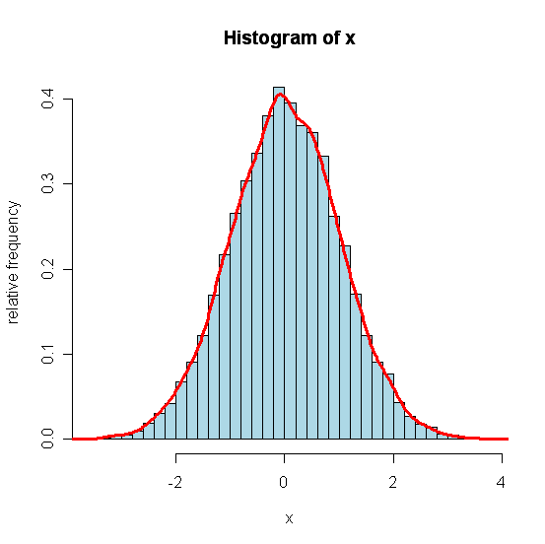
Probability
There is no probability at a specified number.
We must specify an interval of numbers.
6

Slide 7
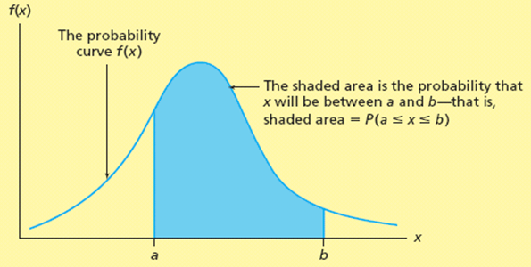
Definition: The curve f(x) is the continuous probability distribution of the continuous random variable x if the probability that x will be in a specified interval of numbers is the area under the curve f(x) corresponding to the interval.
Other names for a continuous probability distribution:
probability curve, or
probability density function.
7

Slide 8
Properties of Continuous Probability Distributions
Properties of f(x):
f(x) is a continuous function such that
f(x) ≥ 0 for all x
The total area under the curve of f(x) is equal to 1.
Essential point: An area under a continuous probability distribution is a probability.
8

Slide 9
Area and Probability
The blue-colored area under the probability curve f(x) from the value x = a to x = b is the probability that x could take any value in the range a to b.
Symbolized as P(a ≤ x ≤ b)
Or as P(a < x < b), because each of the interval endpoints has a probability of 0.
9

Slide 10
As an example of using a continuous probability distribution to describe a random variable, (a) Suppose that the fast-food restaurant studies the temperature of the coffee being dispensed (b) Giving the 48 coffee temperatures in Figure 6.1(a) (c) Figure 6.1(b) shows a percent frequency histogram of the coffee temperatures (d) If we were to smooth out the histogram with a continuous curve, we would get a curve similar to the symmetrical and bell-shaped curve in Figure 6.1(c) (e) One continuous probability distribution that graphs as a symmetrical and bell-shaped curve is the normal probability distribution (or normal curve) (f) The coffee temperature histogram looks like a normal curve. So, it is reasonable to conclude that x, the temperature of a randomly selected cup of coffee at the fast-food restaurant, is described by a normal probability distribution
10

Slide 11
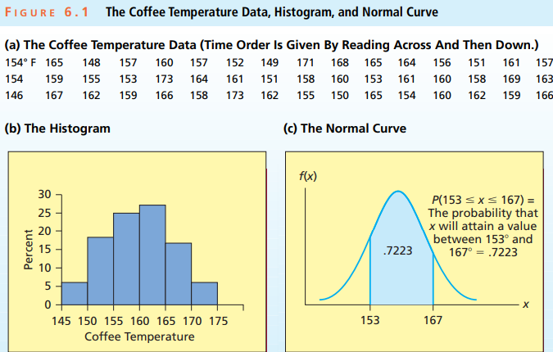
11

Slide 12
(g) Experience shows that the best coffee temperature is between 153° and 167°. (h) It follows that the probability that x will be between 153° and 167° is the area under the coffee temperature normal curve between 153 and 167. (i) In Section 6.3, where we discuss the normal curve in detail, we will find that this area is 0.7223. That is, in probability notation: P(153 < x < 167) = 0.7223 (see the blue area in Figure 6.1(c)). (j) In conclusion, we estimate that 72.23 percent of the coffee served at the restaurant is within the range of temperatures that is best and 27.77 percent of the coffee served is not in this range. If management wishes a very high percentage of the coffee served to taste best, it must improve the coffee-making process by better controlling temperatures.
12

Slide 13
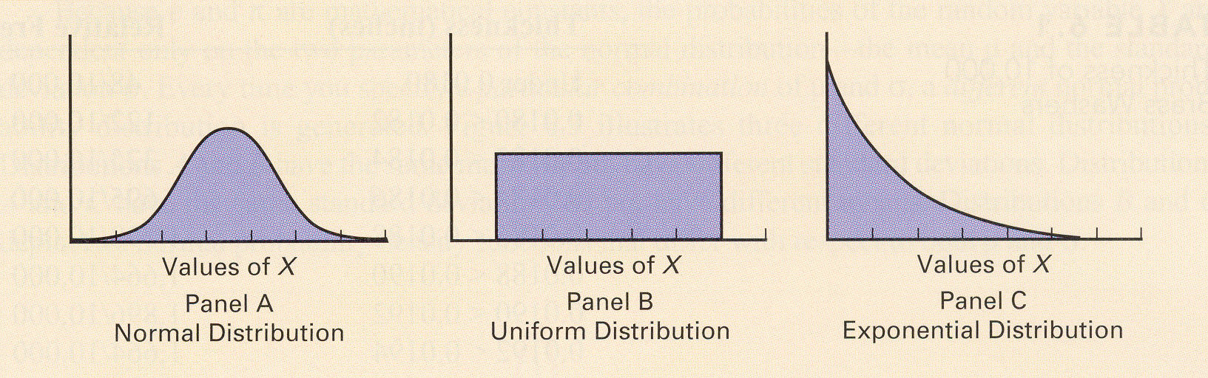
Continuous Probability Distributions
For a continuous random variable, its probability density function gives a complete information about the variable.
The most useful density functions are Normal distribution, uniform distribution and Exponential distribution
13

Slide 14
We have seen that to calculate a probability concerning a continuous random variable, we must compute an appropriate area under the curve f(x).
Because there is no area under a continuous curve at a single point, or number, on the real line, the probability that a continuous random variable x will equal a single numerical value is always equal to 0.
It follows that if [a, b] denotes an arbitrary interval of numbers on the real line, then P(x = a) = 0 and P(x = b) = 0. Therefore, P(a ≤ x ≤ b) equals P(a < x < b) because each of the interval endpoints a and b has a probability that is equal to 0.
14

Slide 15
Distribution Shapes
Symmetrical and rectangular
The uniform distribution
Section 6.2
Symmetrical and bell-shaped
The normal distribution
Section 6.3
Skewed (beyond the scope of this course)
Skewed either left or right
For example, the right-skewed exponential distribution
15

Slide 16
Section 6.2 The Uniform Distribution
16

Slide 17
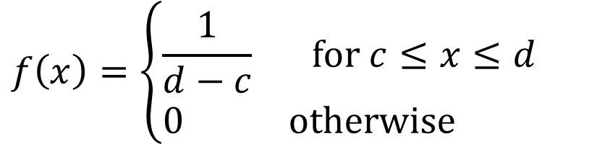
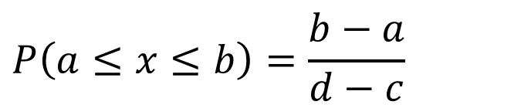
If c and d are numbers on the real line (c < d ), the probability curve describing the uniform distribution is
f(x)
$$f\left(x\right)=\left\{\begin{aligned}&\frac{1}{d−c} \text{for} c≤x≤d \\ &0 \text{otherwise}\end{aligned}\right.$$
x
c
d
The probability that x is any value between the given values a and b (a < b) is
$$P\left(a≤x≤b\right)=\frac{b−a}{d−c}$$
Note: The number ordering is c < a < b < d
17

Slide 18
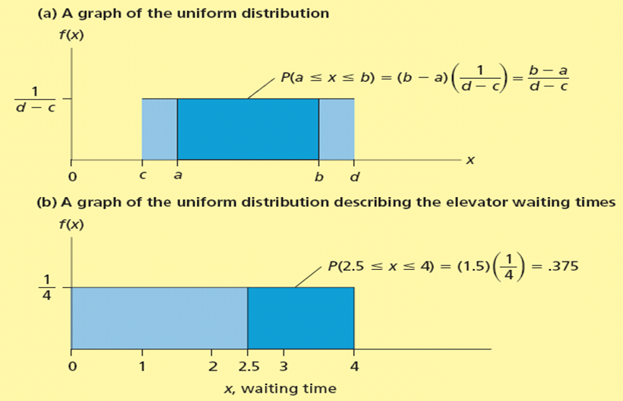
The Uniform Probability Curve
18

Slide 19


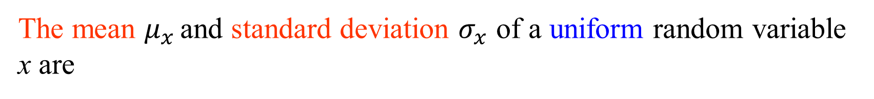
The mean $μ_{x}$ and standard deviation $σ_{x}$ of a uniform random variable x are
$${ μ}_{x}=\frac{c+d}{2}$$ $$σ_{x}=\frac{d−c}{\sqrt{12}}$$
Note: $σ_{x}^{2}=\int_{c}^{d}{{\left(x−{ μ}_{x}\right)}^{2}f\left(x\right)dx}$
19

Slide 20
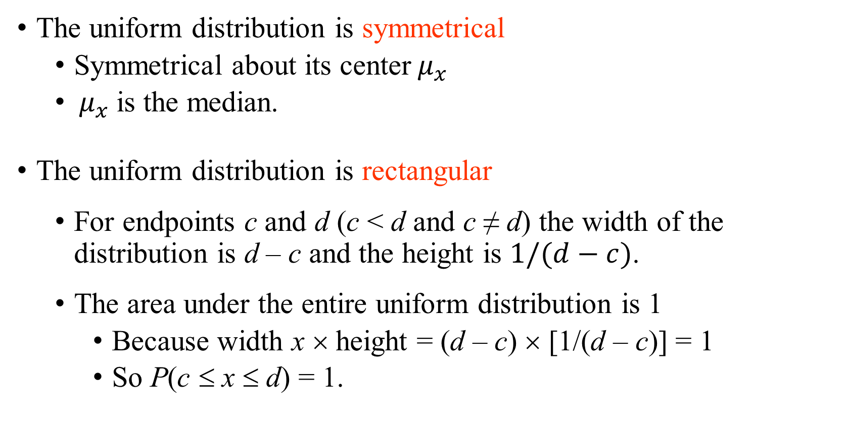
Notes on the Uniform Distribution
The uniform distribution is symmetrical
Symmetrical about its center$μ_{x}$
$μ_{x}$is the median.
The uniform distribution is rectangular
For endpoints c and d (c < d and c ≠ d) the width of the distribution is d – c and the height is $1/(d−c)$.
The area under the entire uniform distribution is 1
Because width x × height = (d – c) × [1/(d – c)] = 1
So P(c ≤ x ≤ d) = 1.
20

Slide 21
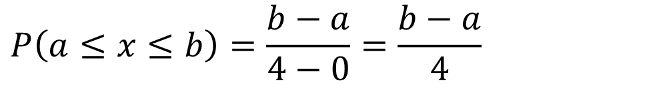
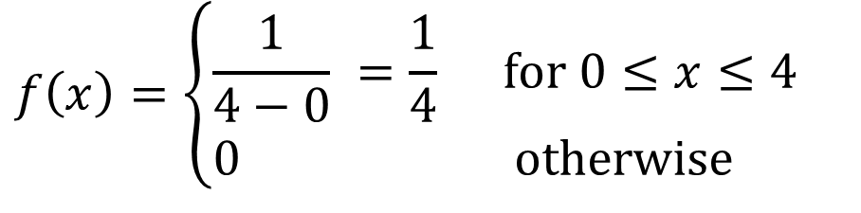
Example 6.1: Elevator Waiting Time #1
The amount of time, x, that a randomly selected hotel patron spends waiting for the elevator at dinner time.
Record suggests x is uniformly distributed between zero and 4 minutes
So c = 0 and d = 4,
$$f\left(x\right)=\left\{\begin{aligned}&\frac{1}{4−0} =\frac{1}{4} \text{for} 0≤x≤4 \\ &0 \text{otherwise}\end{aligned}\right.$$
$$P\left(a≤x≤b\right)=\frac{b−a}{4−0}=\frac{b−a}{4}$$
21

Slide 22
Elevator Waiting Time #2
What is the probability that a randomly selected hotel patron waits at least 2.5 minutes for the elevator?
The probability is the area under the uniform distribution in the interval [2.5, 4] minutes
The probability is the area of a rectangle with height ¼ and base 4 – 2.5 = 1.5
P(x ≥ 2.5) = P(2.5 ≤ x ≤ 4) = ¼ × 1.5 = 0.375
What is the probability that a randomly selected hotel patron waits less than one minutes for the elevator?
P(x ≤ 1) = P(0 ≤ x ≤ 1) = ¼ × 1 = 0.25
22

Slide 23
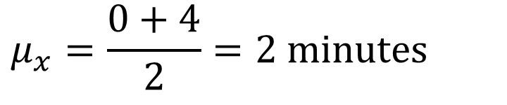

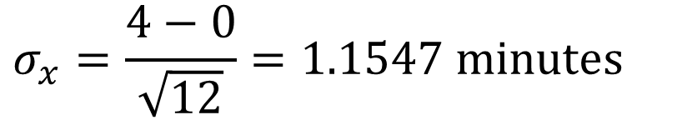
Elevator Waiting Time #3
Expect to wait the mean time $μ_{x}$
with a standard deviation $σ_{x}$ of
$$μ_{x}=\frac{0+4}{2}=2 \text{minutes}$$
$$σ_{x}=\frac{4−0}{\sqrt{12}}=\text{1.1547 }\text{minutes}$$
23

Slide 24
Exercises (if time permits)
6.1 A discrete probability distribution assigns probabilities to individual values. To what are probabilities assigned by a continuous probability distribution?
Answer:
The continuous probability distribution assigns probabilities to individual data regions.
24

Slide 25
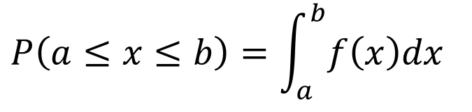
Exercises (if time permits)
6.2 How do we use the continuous probability distribution (or probability curve) of a random variable x to find probabilities? Explain.
Answer:
$$P\left(a≤x≤b\right)=\int_{a}^{b}{f\left(x\right)dx}$$
25

Slide 26
Exercises (if time permits)
6.3 What two properties must be satisfied by a continuous probability distribution (or probability curve)?
Answer:
The probability density function f(x) is higher then 0.
The total area below the probability density function f(x) is 1.
26

Slide 27
Exercises (if time permits)
6.4 Is the height of a probability curve over a given point a probability? Explain.
Answer:
No. the height is the probability density, not the probability.
27

Slide 28
Exercises (if time permits)
6.5 When is it appropriate to use the uniform distribution to describe a random variable x?
Answer: The variable x is uniformly distributed
28

Slide 29
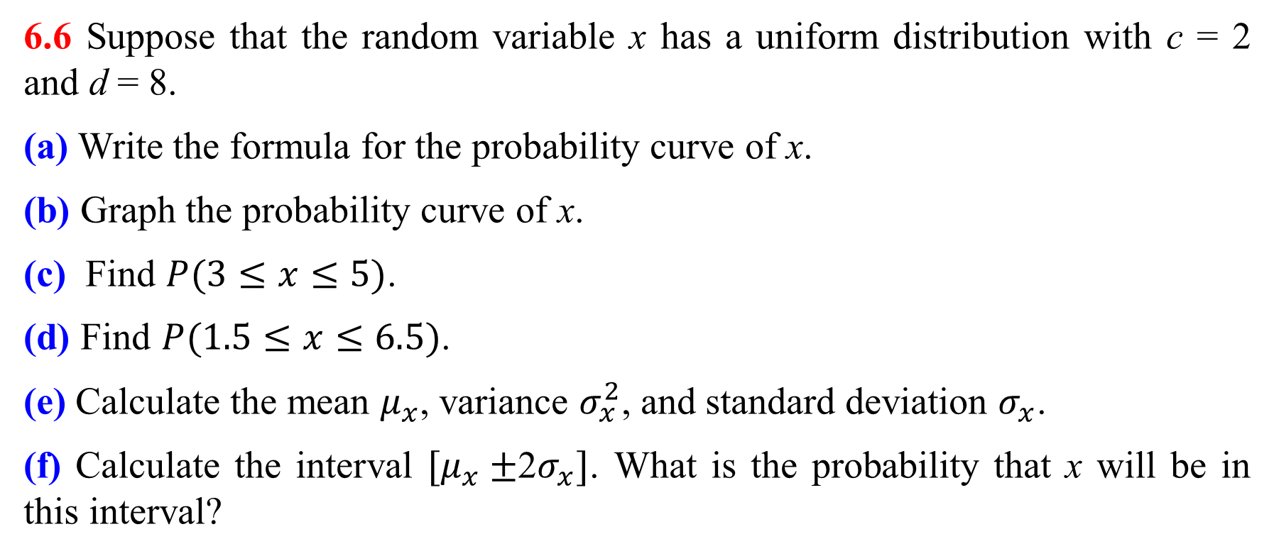
Exercises (if time permits)
6.6 Suppose that the random variable x has a uniform distribution with c = 2 and d = 8.
(a) Write the formula for the probability curve of x.
(b) Graph the probability curve of x.
(c) Find $P(3≤x≤5)$.
(d) Find $P(1.5≤x≤6.5)$.
(e) Calculate the mean $μ_{x}$, variance $σ_{x}^{2}$, and standard deviation $σ_{x}$.
(f) Calculate the interval $[μ_{x}±$2$σ_{x}]$. What is the probability that x will be in this interval?
29

Slide 30
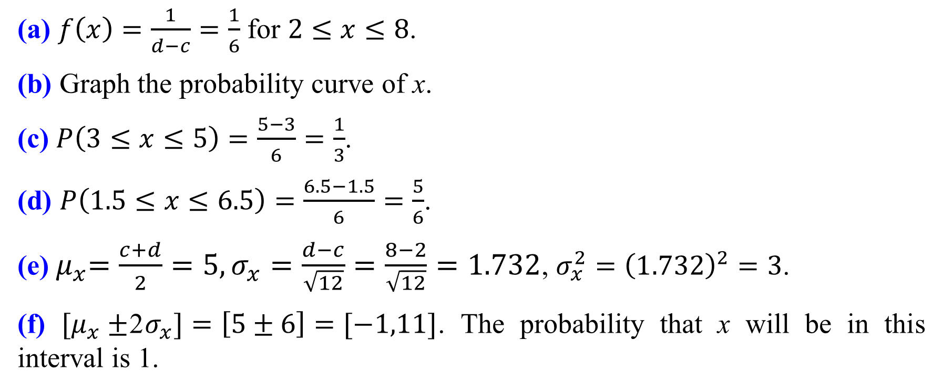
Answer
(a) $f\left(x\right)=\frac{1}{d−c}=\frac{1}{6}$ for $2≤x≤8$.
(b) Graph the probability curve of x.
(c) $P\left(3≤x≤5\right)=\frac{5−3}{6}=\frac{1}{3}$.
(d) $P\left(1.5≤x≤6.5\right)=\frac{6.5−1.5}{6}=\frac{5}{6}$.
(e)${ μ}_{x}=\frac{c+d}{2}=5,σ_{x}=\frac{d−c}{\sqrt{12}}=\frac{8−2}{\sqrt{12}}=1.732$, $σ_{x}^{2}={\left(1.732\right)}^{2}=3$.
(f) $[μ_{x}±$2$σ_{x}]=\left[5±6\right]=[−1,11]$. The probability that x will be in this interval is 1.
30

Slide 31
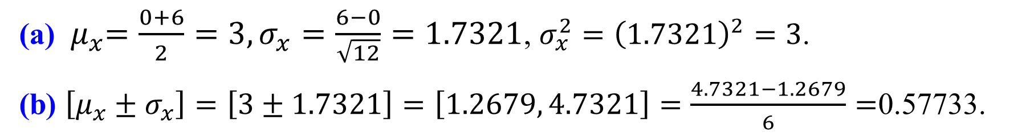
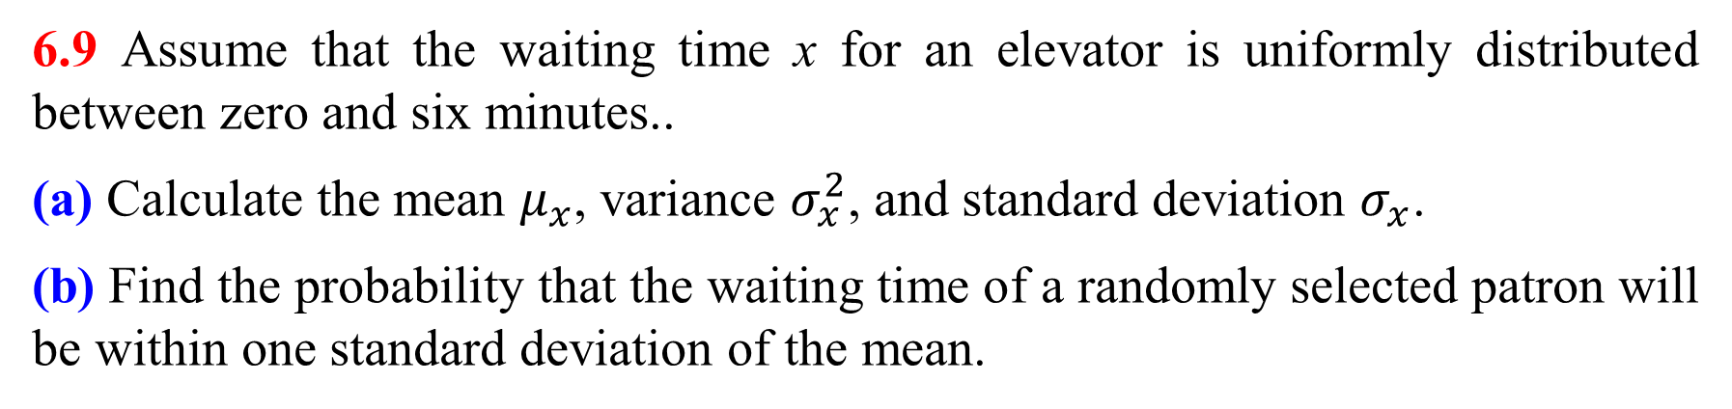
Exercises (if time permits)
6.9 Assume that the waiting time x for an elevator is uniformly distributed between zero and six minutes..
(a) Calculate the mean $μ_{x}$, variance $σ_{x}^{2}$, and standard deviation $σ_{x}$.
(b) Find the probability that the waiting time of a randomly selected patron will be within one standard deviation of the mean.
Answer
(a) ${ μ}_{x}=\frac{0+6}{2}=3,σ_{x}=\frac{6−0}{\sqrt{12}}=1.7321$, $σ_{x}^{2}={\left(1.7321\right)}^{2}=3$.
(b) $\left[μ_{x}±σ_{x}\right]=\left[3±1.7321\right]=\left[1.2679, 4.7321\right]=\frac{4.7321−1.2679}{6}=$0.57733.
31

Slide 32
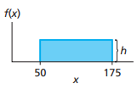
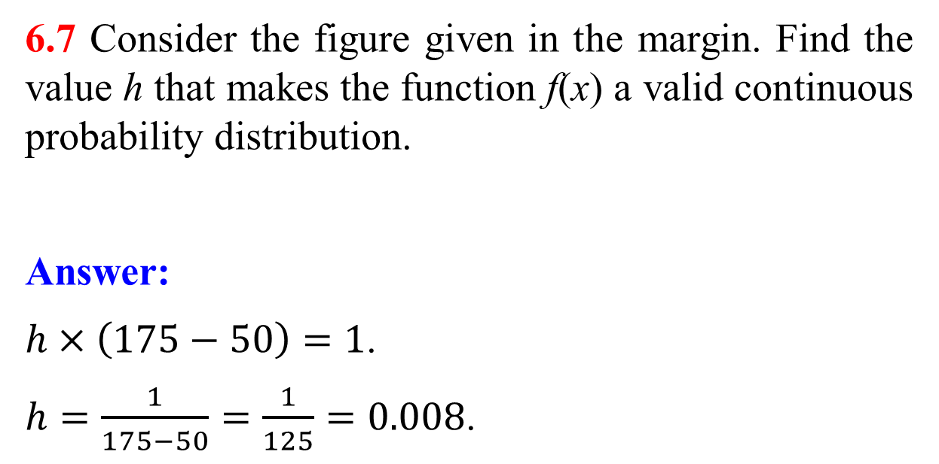
Exercises (if time permits)
6.7 Consider the figure given in the margin. Find the value h that makes the function f(x) a valid continuous probability distribution.
Answer:
$h×\left(175−50\right)=1$.
$h=\frac{1}{175−50}=\frac{1}{125}=0.008$.
32

Slide 33
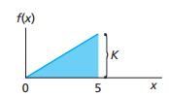
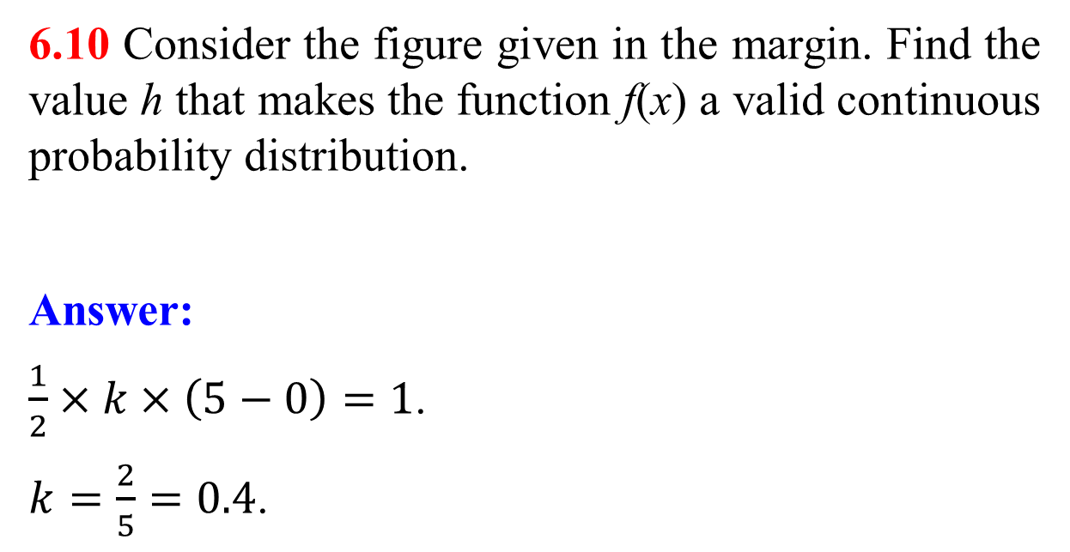
Exercises (if time permits)
6.10 Consider the figure given in the margin. Find the value h that makes the function f(x) a valid continuous probability distribution.
Answer:
$\frac{1}{2}×k×\left(5−0\right)=1$.
$k=\frac{2}{5}=0.4$.
33

Slide 34
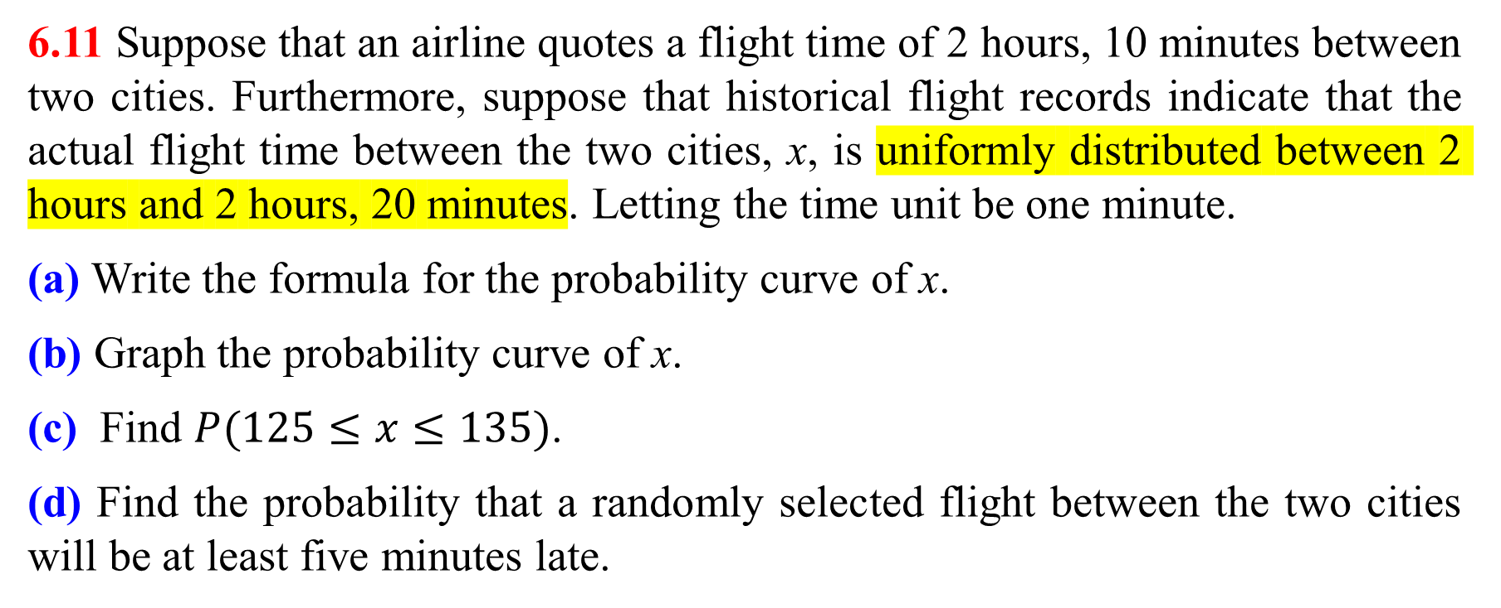
Exercises (if time permits)
6.11 Suppose that an airline quotes a flight time of 2 hours, 10 minutes between two cities. Furthermore, suppose that historical flight records indicate that the actual flight time between the two cities, x, is uniformly distributed between 2 hours and 2 hours, 20 minutes. Letting the time unit be one minute.
(a) Write the formula for the probability curve of x.
(b) Graph the probability curve of x.
(c) Find $P(125≤x≤135)$.
(d) Find the probability that a randomly selected flight between the two cities will be at least five minutes late.
34

Slide 35
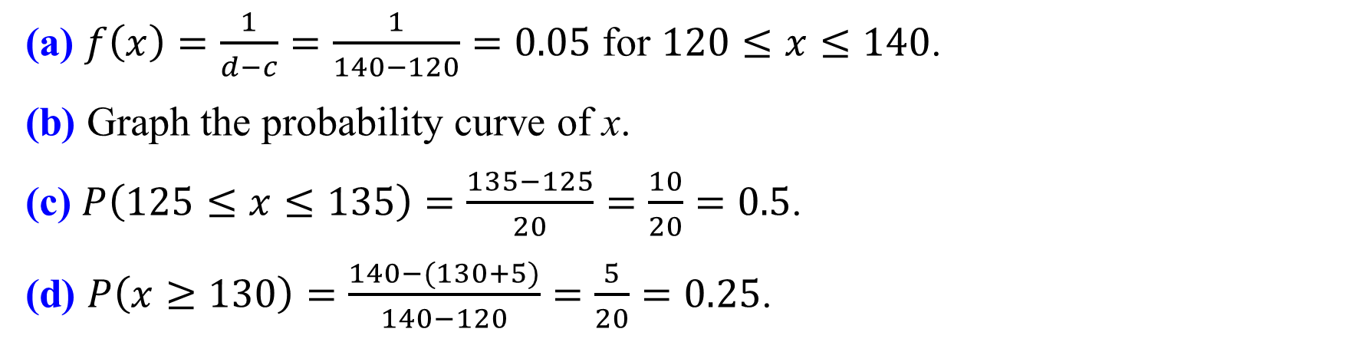
Answer
(a) $f\left(x\right)=\frac{1}{d−c}=\frac{1}{140−120}=0.05$ for $120≤x≤140$.
(b) Graph the probability curve of x.
(c) $P\left(125≤x≤135\right)=\frac{135−125}{20}=\frac{10}{20}=0.5$.
(d) $P\left(x≥130\right)=\frac{140−(130+5)}{140−120}=\frac{5}{20}=0.25$.
35

Slide 36
End of Lecture 10
36

Slide 37
Section 6.3 The Normal Distribution
37

Slide 38
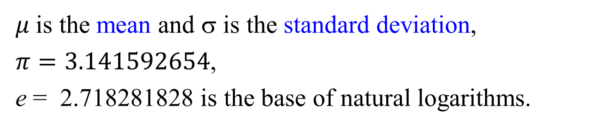
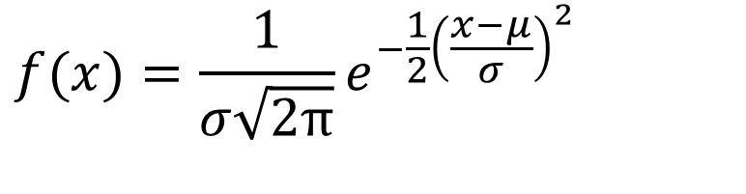
The normal probability distribution is defined by the equation
f(x)
$$f(x)=\frac{1}{σ\sqrt{2π}}e^{−\frac{1}{2}{\left(\frac{x−μ}{σ}\right)}^{2}}$$
for all values x on the real number line, where
$μ$is the mean and σ is the standard deviation,
$π=3.141592654$,
e = 2.718281828 is the base of natural logarithms.
x
μ
38

Slide 39
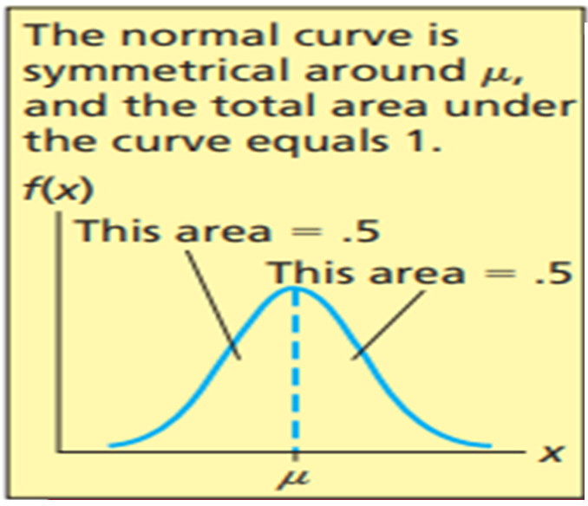
39

Slide 40
Properties of the Normal Distribution
1. There are an infinite number of normal curves
The shape of any individual normal curve depends on its specific mean and standard deviation.
2. The highest point is over the mean,
Also the median and mode.
f(x)
x
μ
40

Slide 41
3. The curve is symmetrical about its mean
The left and right halves of the curve are mirror images of each other.
4. The tails of the normal extend to infinity in both directions
The tails get closer to the horizontal axis but never touch it.
5. The area under the normal curve to the right of the mean equals the area under the normal to the left of the mean
The area under each half is 0.5.
f(x)
x
μ
41

Slide 42
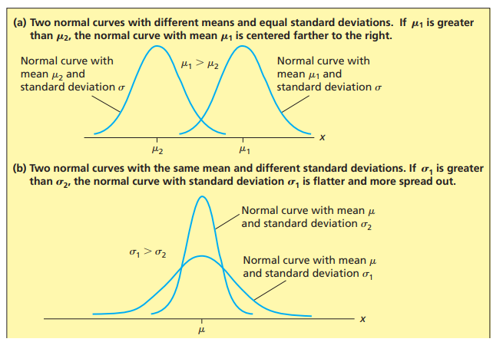
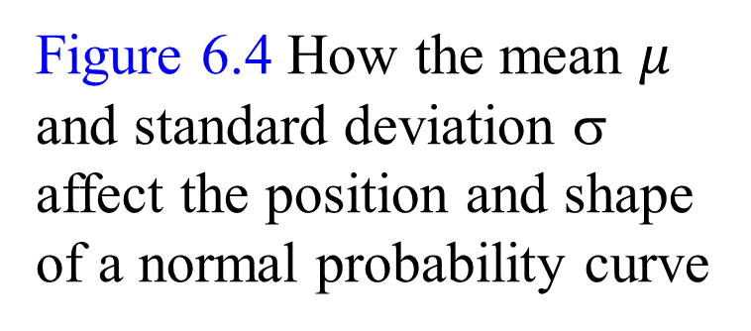
The Position and Shape of the Normal Curve
Figure 6.4 How the mean $μ$ and standard deviation σ affect the position and shape of a normal probability curve
42

Slide 43
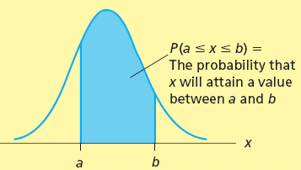
Normal Probabilities
Suppose x is a normally distributed random variable with mean m and standard deviation s.
The probability that x could take any value in the range between two given values a and b (a < b) is P(a ≤ x ≤ b)
P(a ≤ x ≤ b) is the area colored in blue under the normal curve and between the values x = a and x = b
43

Slide 44
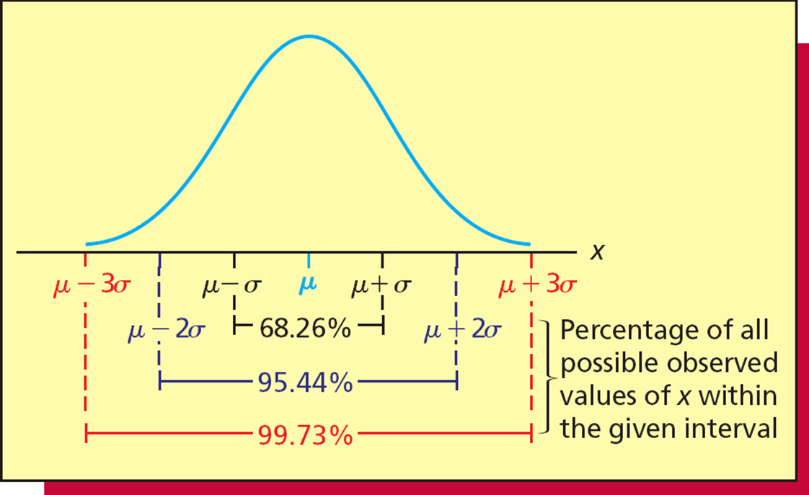
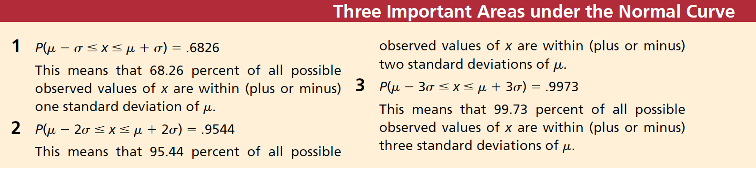
Three Important Percentages (We also know this in Chapter 3)
44

Slide 45
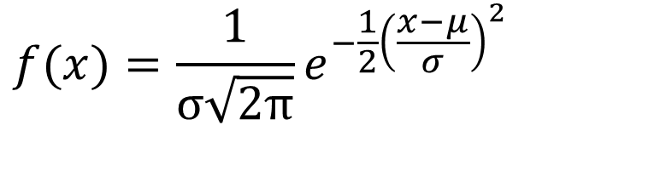
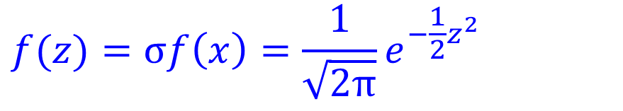
z - scores
Look the normal probability distribution (Slide # 37):
$$f(x)=\frac{1}{σ\sqrt{2π}}e^{−\frac{1}{2}{\left(\frac{x−μ}{σ}\right)}^{2}}$$
For different values of x, the distribution functions in x are different.
If $x$is normalized by $z=\frac{x−μ}{σ}$, the equation becomes
$$f(z)=σf\left(x\right)=\frac{1}{\sqrt{2π}}e^{−\frac{1}{2}z^{2}}$$
If x changes, the distribution function $f\left(z\right)$in z does not change.
45

Slide 46
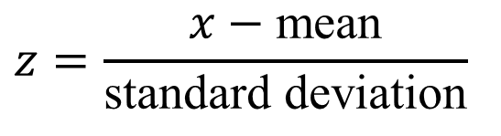
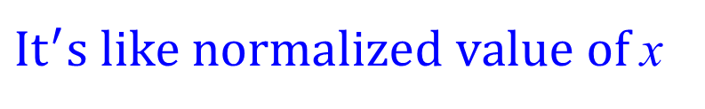
For any x in a population or sample, the z-score corresponding to x is defined as
The z-score, which is also called the standardized value (normalized value). It is the number of standard deviations that x is from the mean
A positive z-score is for x above the mean
A negative z-score is for x below the mean
The mean has a z-score of zero
$$z=\frac{x−\text{mean}}{\text{standard} \text{deviation}}$$
$It^{′}s like normalized value of$x
46

Slide 47
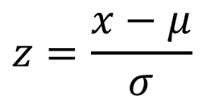
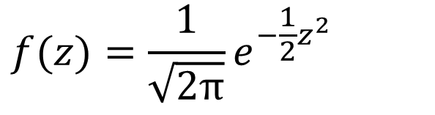
The Standard Normal Distribution
If x is normally distributed with mean μ and standard deviation σ, then the random variable z
$$z=\frac{x−μ}{σ}$$
is normally distributed with mean 0 and standard deviation 1; this normal is called the standard normal distribution.
Standard normal distribution: it is normally distribution, it has mean 0 and standard deviation 1.
$$f(z)=\frac{1}{\sqrt{2π}}e^{−\frac{1}{2}z^{2}}$$
47

Slide 48
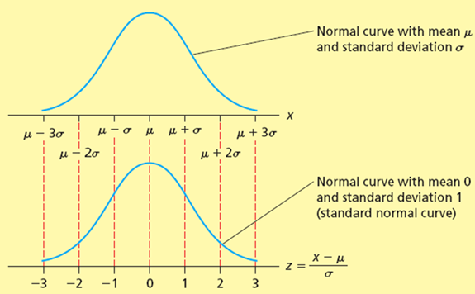
z measures the number of standard deviations that x is from the mean μ.
The algebraic sign on z indicates on which side of μ is with x
z is positive if x > μ (x is to the right of μ on the number line)
z is negative if x < μ (x is to the left of μ on the number line)
48

Slide 49
The Standard Normal Table
The standard normal table is a table that lists the cumulative areas under the standard normal curve.
This table is very important/useful.
Always look at the accompanying figure for guidance on how to use the table
49

Slide 50
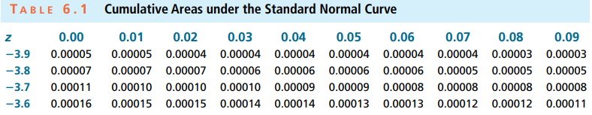
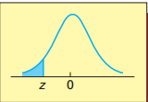

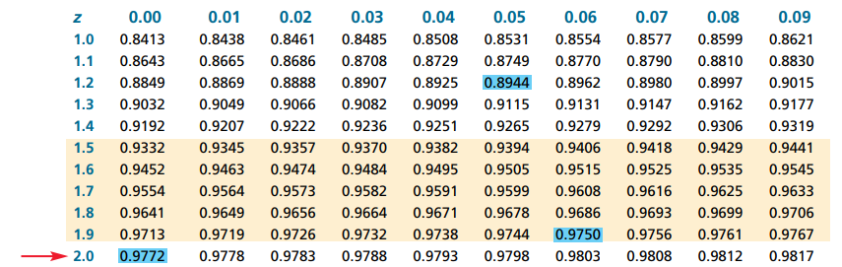
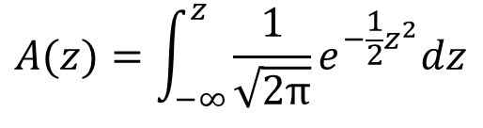
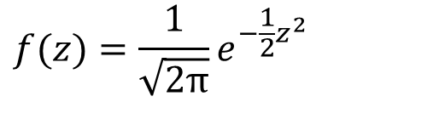
The Cumulative Normal Table
(Continued)
$$f(z)=\frac{1}{\sqrt{2π}}e^{−\frac{1}{2}z^{2}}$$
(Continued)
$$A(z)=\int_{−∞}^{z}{\frac{1}{\sqrt{2π}}e^{−\frac{1}{2}z^{2}}dz}$$
50

Slide 51
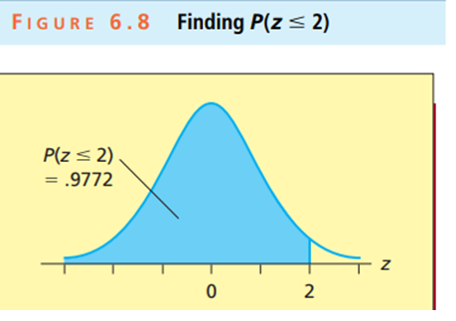
Example: Find the area under the standard normal curve to the left of a z value of 2.00.
Answer: This area, which equals 0.9772, is the probability that the random variable z will be less than or equal to 2.00. That is, we have found that P(z < 2) = 0.9772.
51

Slide 52
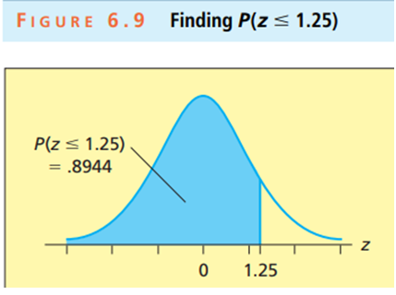
Example: Find the area under the standard normal curve to the left of the z value 1.25.
Answer: This area (also shaded blue) is 0.8944. That is, P(z < 1.25) = 0.8944.
52

Slide 53
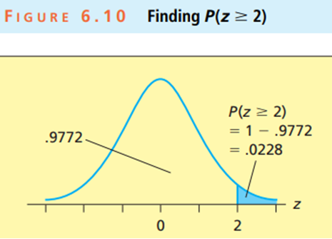
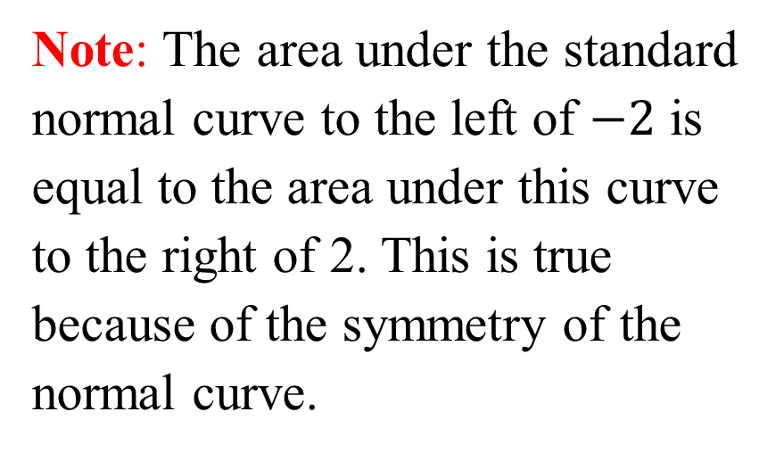
Example: Find the area under the standard normal curve to the right of a z value of 2 — that is, we wish to find P(z > 2).
Answer: $P\left(z≥2\right)=1−P\left(z≤2\right)=1−0.9772=0.0228$.
Note: The area under the standard normal curve to the left of $−2$ is equal to the area under this curve to the right of 2. This is true because of the symmetry of the normal curve.
53

Slide 54


Example: Find the area under the standard normal curve to the left of a z value of $P\left(z≤−2\right)$.
Answer: $P\left(z≤−2\right)=0.0228$.
54

Slide 55


The smallest z value in Table 6.1 is $−$3.99, and the table tells us that the area under the standard normal curve to the left of $−3.99$ is 0.00003 (see Figure 6.13). Therefore, if we wish to find the area under the standard normal curve to the left of any z value less than 3.99, the most we can say (without using a computer) is that this area is less than 0.00003. Similarly, the area under the standard normal curve to the right of any z value greater than 3.99 is also less than 0.00003 (see Figure 6.13).
55

Slide 56
End of Lecture 11
56

Slide 57

Example: Calculating $P(−2.53≤z≤2.53)$
Answer:
Step 1: Knowing that $P\left(−2.53≤z≤2.53\right)=P\left(z≤2.53\right)−$ $P\left(z≤−2.53\right)$.
Step 2: Find $P\left(z≤2.53\right)$. Go to the table of areas under the standard normal curve. Go down left-most column for z = 2.5. Go across the row 2.5 to the column headed by 0.03.
The cumulative area to the value of z = 2.53 is the value contained in the cell that is the intersection of the 2.5 row and the 0.03 column. The table value for the area (next slide) is 0.9943. So, $P\left(z≤2.53\right)=0.9943.$
Step 3: Find $P\left(z≤−2.53\right)$ (next, next slide). By symmetry, $P\left(z≤−2.53\right)=P\left(z≥2.53\right)= 1−P\left(z≤2.53\right)=1−0.9943=0.0057$.
Step 4: $P\left(−2.53≤z≤2.53\right)=0.9943−0.0057=0.9886.$
57

Slide 58

58

Slide 59

59

Slide 60




Finding Normal Probabilities of x
General procedure:
Step 1: Formulate the problem in terms of x values.
Step 2: Calculate the corresponding z values, and restate the problem in terms of these z values.
Step 3: Find the required areas under the standard normal curve by using the table.
Note: It is always useful to draw a picture showing the required areas before using the normal table.
$$f\left(x\right)=\frac{1}{σ\sqrt{2π}}e^{−\frac{1}{2}{\left(\frac{x−μ}{σ}\right)}^{2}}$$
$$z=\frac{x−μ}{σ}$$
$$f(z)=\frac{1}{\sqrt{2π}}e^{−\frac{1}{2}z^{2}}$$
$$f\left(x\right)=\frac{f\left(z\right)}{σ}$$
60

Slide 61







Probability is the area under the curve!
f(x)
$$P\left(a≤x≤b\right)$$
x is normal random variable with mean $μ$
and standard deviation σ.
$$z=\frac{x−μ}{σ}$$
z follows standard normal distribution
a
b
x
The probability for $a≤x≤b$is equivalent to the probability for $\frac{a−μ}{σ}≤z≤\frac{b−μ}{σ}$
f(z)
$$P\left(a≤x≤b\right)=P\left(\frac{a−μ}{σ}≤z≤\frac{b−μ}{σ}\right)$$
$$\frac{a−μ}{σ}$$
$$\frac{b−μ}{σ}$$
z
61

Slide 62


Figure 6.15 Some Areas under the Standard Normal Curve $f(z)$
$P\left(−1≤z≤1\right)=0.6826$. We know that 68.26 percent of all possible observed values of x are between a point that is one standard deviation below μ (where z equals 1) and a point that is one standard deviation above μ (where z equals 1). That is, 68.26 percent of all possible observed values of x are within (plus or minus) one standard deviation of the mean μ.
95.44 percent of all possible observed values of x are within (plus or minus) two standard deviations of the mean μ.
99.73 percent of all possible observed values of x are within (plus or minus) three standard deviations of the mean μ.
62

Slide 63

Three Important Areas under the Normal Curve $f(x)$
1. $P\left(μ−σ≤x≤μ+σ\right)=0.6826$.
So 68.26% of all possible observed values of x are within (plus or minus) one standard deviation of $μ$.
2. $P\left(μ−2σ≤x≤μ+2σ\right)=0.9544$.
So 95.44% of all possible observed values of x are within (plus or minus) two standard deviations of $μ$.
3. $P\left(μ−3σ≤x≤μ+3σ\right)=0.9973$.
So 99.73% of all possible observed values of x are within (plus or minus) three standard deviations of $μ$
63

Slide 64

The Empirical Rule for Normal Populations
If a population has mean $μ$ and standard deviation $$ and is described by a normal curve (symmetrical, bell-shaped distribution), then
1. 68.26% of the population measurements lie within one standard deviation of the mean: $[μ−σ,μ+σ]$.
2. 95.44% of the population measurements lie within two standard deviations of the mean: $[μ−2σ,μ+2σ]$.
3. 99.73% of the population measurements lie within three standard deviations of the mean: $[μ−3σ,μ+3σ]$.
64

Slide 65

Empirical Rule for Normal Populations
65

Slide 66
Example 6.2 The Car Mileage Case: Estimating Mileage
Want: the probability that the mileage of a randomly selected midsize car will be between 32 and 35 mpg.
Let x be the random variable of mileage of midsize cars, in mpg
Want to know P(32 ≤ x ≤ 35 mpg)
Given: x is normally distributed
μ = 33 mpg
σ = 0.7 mpg
66

Slide 67





Original question: Find P(32 $≤x≤$35 mpg) for $μ$ = 33 mpg and $σ=0.7$ mpg
Equivalent question: Find P($\frac{32−33}{0.7}$ $≤z≤ \frac{35−33}{0.7}$) for $μ=0$ mpg and $σ=1$
Note: $z=\frac{x−μ}{σ}$
From the normal table:
P($−1.43≤z≤2.86)$
$=0.9979−0.0764=0.9215$.
92.15 percent of all of midsize cars will get mileages between 32 mpg and 35 mpg.
67

Slide 68
Problem
The daily water usage per person in Providence, Rhode Island is normally distributed with a mean of 20 gallons and a standard deviation of 5 gallons. What percent of the population use between 18 and 26 gallons per day?
Solution:
68

Slide 69

Example 6.4 The Coffee Temperature Case: Meeting Customer Requirements
Recall that marketing research done by a fast-food restaurant indicates that coffee tastes best if its temperature is between 153 (F) and 167 (F). The restaurant has sampled the coffee it serves and observed the 48 temperature readings in Table 1.10 on page 17 (Also see Chapter 1 of teaching notes). The temperature readings have a mean $\overline{x}=159.3958$ and a standard deviation s = 6.4238 and are described by a bell-shaped histogram. Using $\overline{x}$ and s as point estimates of the mean μ and the standard deviation σ of the population of all possible coffee temperatures, we wish to calculate the probability that x, the temperature of a randomly selected cup of coffee, is outside the customer requirements for best-testing coffee (that is, less than 153°or greater than 167°). In order to compute the probability $P(x<153$or $x>167)$.
69

Slide 70



$$z=\frac{153−159.3958}{6.4238}=−1.00$$
$$z=\frac{167−159.3958}{6.4238}=1.18$$
$P(x<153$or $x>167)=P\left(x<153\right)+P(x>167)$
$$=P\left(z<−1.0\right)+P(z>1.18)$$
$$=0.1587+0.1190=0.2777$$
This calculation is illustrated in Figure 6.18. The probability of 0.2777 implies that 27.77 percent of the coffee temperatures do not meet customer requirements and 72.23 percent of the coffee temperatures do meet these requirements. If management wishes a very high percentage of its coffee temperatures to meet customer requirements, the coffee-making process must be improved.
70

Slide 71



Finding z Points on a Standard Normal Curve
In general, we let $z_{α}$ denote the point on the horizontal axis under the standard normal curve that gives a right-hand tail area equal to $α$.
$z_{α}$ is a point,
$α$ is the area on the right side of $z_{α}$.
We will use this in Chapter 8.
71

Slide 72
Example 6.5 The DVD Case: Managing Inventory
A large discount store sells DVD cases.
If the store keep too many DVD cases, the holding cost is high.
If the store keep too fewer DVD cases, they may be not enough to meet the demand of the customers.
The store manager wants to know how many DVD cases to keep (at the beginning of the week) so that there is only a 5 percent chance of “No enough DVD cases” during the week.
Known: the demand is normally distributed with m = 100 tapes and s = 10 tapes.
72

Slide 73
Checking the conditions
Let x be the random variable of weekly demand.
Let st be the number of tapes so that there is only a 5% probability that weekly demand will exceed st.
Want to find the value of st for P(x ≥ st) = 0.05.
Known: the demand is normally distributed with m = 100 tapes and s = 10 tapes.
73

Slide 74

74

Slide 75

75

Slide 76

Step #1
Refer to the above figure.
In panel (a), st is located on the horizontal axis under the right-tail of the normal curve having mean m = 100 and standard deviation s = 10.
The z value corresponding to st is
$z=\frac{st−μ}{σ}=\frac{st−100}{10}$
In panel (b), the right-tail area is 0.05, so the cumulative area under the standard normal curve to z is 1 – 0.05 = 0.95.
76

Slide 77

Step #2
Use the standard normal table (above table) to find the z value associated with a table entry of 0.95
But do not find 0.95; instead, find values that bracket 0.95
For a table entry of 0.9495, z = 1.64
For a table entry of 0.9505, z = 1.65
For an area of 0.95, use the z value midway between these.
So z = 1.645
$\frac{st−μ}{σ}=\frac{st−100}{10}$ =1.645
Solving for s gives st = 100 + (1.645 × 10) = 116.45.
Rounding up, 117 tapes should be stocked so that the probability of running out will not be more than 5 percent.
77

Slide 78

Question (if time permits)
Suppose x is normal with mean 8.0 and standard deviation 5.0
Find P(x < 8.6)
Find P(8 < x < 8.6)
Find P(7.4 < x < 8)
Find the x value so that only 20% of all values are below this x.
Hint: $z=\frac{x−μ}{σ}=\frac{x−8.0}{5.0}$
78

Slide 79

Finding a Tolerance Interval
Finding a tolerance interval [μ ± kσ] that contains 99% of the measurements in a normal population
79

Slide 80

Example 6.6 Setting A Guarantee Period
Extensive testing indicates that the lifetime of the Everlast automobile battery is normally distributed with a mean of $μ=60$ months and a standard deviation of $σ=6$months. The Everlast’s manufacturer has decided to offer a free replacement battery to any purchaser whose Everlast battery does not last at least as long as the minimum lifetime specified in its guarantee. How can the manufacturer establish the guarantee period so that only 1 percent of the batteries will need to be replaced free of charge?
80

Slide 81





Solution
If the battery will be guaranteed to last l months, l must be chosen to allow only a 0.01 probability that the lifetime, of an Everlast battery will be less than l. That is, we must choose l so that
From the figure and the table (next slide), we find $−z_{0.01}=−2.33$. So
$$−2.33=\frac{l−60}{6}$$
$$P\left(x<l\right)=0.01$$
$l=46.02$months
No more than 1 percent of the batteries will need to be replaced free of charge, it seems reasonable to guarantee the Everlast battery to last 46 months.
81

Slide 82

82

Slide 83
Exercises (if time permits)
6.18 If the random variable x is normally distributed, what percentage of all possible observed values of x will be
(a) Within one standard deviation of the mean?
(b) Within two standard deviations of the mean?
(c) Within three standard deviations of the mean?
Answer
(a) 68.26%.
(b) 95.44%.
(c) 99.73%.
83

Slide 84


Exercises (if time permits)
6.19 Explain how to compute the z value corresponding to a value of a normally distributed random variable. What does the z value tell us about the value of the random variable?
Answer
$$z=\frac{x−μ}{σ}$$
$$x=σz+μ$$
84

Slide 85

Exercises (if time permits)
6.21 Why do we compute z values when using the normal table? Explain.
Answer
The normal table tells us the probability density function of z. If we want to compute $f\left(x\right), we need to compute f\left(z=\frac{x−μ}{σ}\right)$
85

Slide 86

Exercises (if time permits)
6.22 In each case, sketch the two specified normal curves on the same set of axes:
(a) A normal curve with $μ=20$ and $σ=3$, and a normal curve with $μ=20$ and $σ=6$.
(b) A normal curve with $μ=20$ and $σ=3$, and a normal curve with $μ=30$ and $σ=3$.
(c) A normal curve with $μ=100$ and $σ=10$, and a normal curve with $μ=200$ and $σ=20$.
Answer
86

Slide 87

Exercises (if time permits)
6.24 If the random variable z has a standard normal distribution, sketch and find each of the following probabilities:
(a) $P(0≤z≤1.5)\text{ (}\text{b}\text{) }P(z≥2)$ (c) $P(z≤1.5)$ (d) $P(z≥−1.0)$
(e) $P(−2.5≤z≤0.5)$.
Answer
87

Slide 88

Exercises (if time permits)
6.26 Suppose that the random variable x is normally distributed with mean $μ=1,000$ and standard deviation $σ=100$. Sketch and find each of the following probabilities:
(a) $P(1,000≤x≤1,200)\text{ (}\text{b}\text{) }P(x≥1,257)$ (c) $P(x≤1,035)$
(d) $P(857≤x≥1,183)$ (e) $P(x≤700)$.
Answer
88

Slide 89

Exercises (if time permits)
6.27 Suppose that the random variable x is normally distributed with mean$μ=500$ and standard deviation $σ=100$. For each of the following, use the normal table to find the needed value k. In each case, draw a sketch.
(a) $P\left(x≥k\right)=0.025 \text{(}\text{d}\text{) }P\left(x≤k\right)=0.015$
(g) $P\left(x≤k\right)=0.975$ $\text{(}\text{i}\text{) }P\left(x>k\right)=0.9772$
Answer
(a)$P\left(x≥k\right)=P\left(z≥\frac{k−500}{100}\right),z_{0.025}=1.96\text{,}\frac{k−500}{100}=1.96,k=696$
(d)$P\left(x≤k\right)=1−P\left(z>\frac{k−500}{100}\right),z_{0.985}=−2.17\text{,}\frac{k−500}{100}=−2.17,k=283$
(g)$P\left(x≤k\right)=1−P\left(z>\frac{k−500}{100}\right),z_{0.025}=1.96\text{,}\frac{k−500}{100}=1.96,k=696$
(i)$P\left(x>k\right)=P\left(z≥\frac{k−500}{100}\right),z_{0.9772}=−2\text{,}\frac{k−500}{100}=−2,k=300$
89

Slide 90
Exercises (if time permits)
6.28 Stanford–Binet IQ Test scores are normally distributed with a mean score of 100 and a standard deviation of 16.
(a) Sketch the distribution of Stanford–Binet IQ test scores.
(b) Write the equation that gives the z score corresponding to a Stanford–Binet IQ test score. Sketch the distribution of such z scores
(c) Find the probability that a randomly selected person has an IQ test score (1) Over 140. (2) Under 88. (3) Between 72 and 128. (4) Within 1.5 standard deviations of the mean
(d) Suppose you take the Stanford–Binet IQ Test and receive a score of 136. What percentage of people would receive a score higher than yours?
90

Slide 91

Solution
(a).
(b) $P\left(x\right)=P\left(z=\frac{x−μ}{σ}\right)$ $=P\left(z=\frac{x−100}{16}\right)$
(c)
(1) $P\left(x>140\right)=P\left(z>2.5\right)=1−P\left(z≤2.5\right)=1−0.9938=0.0062$.
(2) $P\left(x<28\right)=P\left(z<−4.5\right)≅0$.
(3)$P\left(72≤x≤128\right)=P\left(−1.75≤z≤1.75\right)=1−2P\left(z≤−1.75\right)=1−2\left(0.0401\right)=0.9198$.
(4) $P\left(100−1.5(16)≤x≤100+1.5(16\right))=P\left(−1.5≤z≤1.5\right)=1−2P\left(z≤−1.5\right)=1−2\left(0.0668\right)=0.8664$.
(d) $P\left(x>136\right)=P\left(z>2.25\right)=1−P\left(z≤2.25\right)=1−0.9878=0.0122$.
91

Slide 92

Exercises (if time permits)
6.31 United Motors claims that one of its cars, the Starbird 300, gets city driving mileages that are normally distributed with a mean of 30 mpg and a standard deviation of 1 mpg. Let x denote the city driving mileage of a randomly selected Starbird 300.
(a)Assuming that United Motors’ claim is correct, find $P\left(x≤27\right)$.
(b) If you purchase (randomly select) a Starbird 300 and your car gets 27 mpg in city driving, what do you think of United Motors’ claim? Explain your answer.
Answer
(a)$P\left(x≤27\right)=P\left(z≤\frac{27−30}{1}\right)=P\left(z≤−3\right)=0.00135$
(d) The claim is probably not true.
92

Slide 93


Exercises (if time permits)
6.33 A filling process is supposed to fill jars with 16 ounces of grape jelly. Specifications state that each jar must contain between 15.95 ounces and 16.05 ounces. A jar is selected from the process every half hour until a sample of 100 jars is obtained. When the fills of the jars are measured, it is found that $\overline{x}=16.0024$ and s = 0.02454. Using and s as point estimates of $μ$ and $σ$, estimate the probability that a randomly selected jar will have a fill, x, that is out of specification. Assume that the process is in control and that the population of all jar fills is normally distributed.
Answer
(a)$P\left(x≤15.95\right)+P\left(x≥16.05\right)=P\left(x≤15.95\right)+1−P\left(x≤16.05\right)$
$$=P\left(z≤\frac{15.95−16.0024}{0.02454}\right)+1−P\left(z≤\frac{16.05−16.0024}{0.02454}\right)$$
$=$ $P\left(z≤−2.135\right)+1−P\left(z≤1.940\right)=0.0164+1−0.9738=0.0426$
93

Slide 94


Exercises (if time permits)
6.41 Suppose that the 33rd percentile of a normal distribution is equal to 656 and that the 97.5th percentile of this normal distribution is 896. Find the mean $μ$ and the standard deviation$σ$of the normal distribution.
Answer
$$z_{0.33}=−0.44,z_{0.975}=1.96$$
$$−0.44=\frac{656−μ}{σ},1.96=\frac{896−μ}{σ}$$
$$μ=700,σ=100$$
94

Slide 95
Thank you!

